Slide 1
Capstone Project - 2
Bike Sharing Demand Prediction
Team members Honaji Phad

Slide 2
Content
Introduction
Problem definition
Hypothesis
EDA on given data
Statistical Data Analysis
Model implementation
Model validation and selection
Conclusion
References

Slide 3
Introduction
According to recent studies, it is expected that more than 60% of the population in the world tends to dwell in cities.
Urban mobility usually fills 64% of the entire kilometres travelled in the world.
Currently Rental bikes are introduced in many urban cities for the enhancement of mobility comfort.
As a convenient, economical, and eco-friendly travel mode, bike-sharing greatly improved urban mobility.

Slide 4
Introduction
It is eco-friendly and comfortable compared to driving.
Ggenerally travelling by bike takes less time than walking.
Usually it is difficult to maintain the balance in between demand of bikes in cities.
Aim of the project is to put a model on given data for prediction of bikes.

Slide 5
Problem definition
The main goal of the project is to Finding factors and cause those influence shortages of bike and time delay of availing bike on rent.
Maximize: The availability of bikes to the customer.
Minimize: Minimise the time of waiting to get a bike on rent.

Slide 6
Hypothesis
From data and problem statement we would like to put hypothesis on 5 features as.
In season summer bike demand will be more.
If there is less visibility bike demand will be less.
In the hours 9 am and 7 pm demands will be more.
On Sunday bike demands will be less.
With rainfall and snow fall demands of bike will be reduced.
At end we will see either we reject the hypothesis or fail to reject it.

Slide 7
EDA
Digging into data we understand that
Dataset contains 13 features such as
Date : year-month-day
Hour - Hour of the day
Temperature-Temperature in Celsius
Humidity - %
Windspeed - m/s
Visibility - 10m
Dew point temperature - Celsius
Solar radiation - MJ/m2
Rainfall - mm

Slide 8
EDA
Snowfall - cm
Seasons - Winter, Spring, Summer, Autumn
Holiday - Holiday/No holiday
Functional Day - No Func (Non Functional Hours), Fun (Functional hours)
Response variable is :
Rented Bike count - Count of bikes rented at each hour
Graphical representation according to various columns and with manipulation of columns.

Slide 9
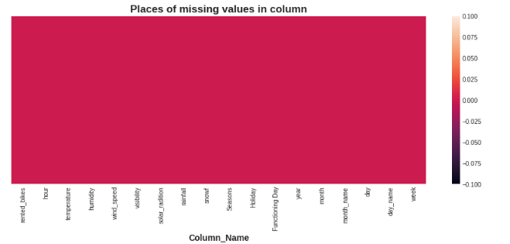
EDA
We can see there is no null values in the given data set.
Fig 1: Missing values in data set.

Slide 10
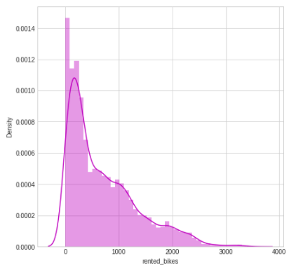
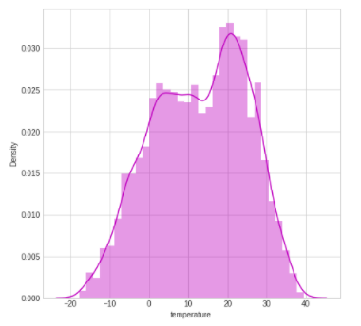
EDA
Rented bike counts are positively skewed and temperature is normally distributed.
Fig 2: Distribution of rented bike counts.
Fig 3: Distribution of temperature.

Slide 11
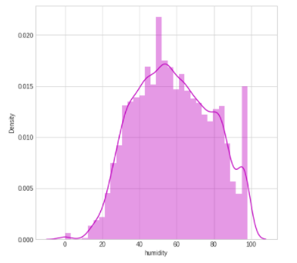
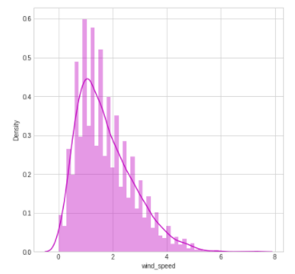
EDA
Humidity is normally distributed and wind speed is positively skewed.
Fig 4: Distribution of Humidity.
Fig 5: Distribution of Wind speed.

Slide 12
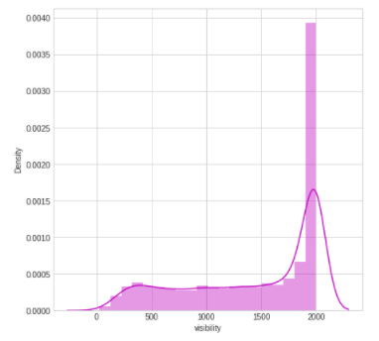
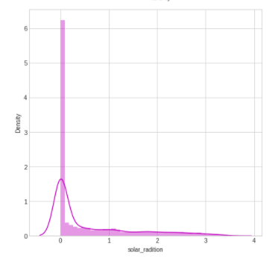
EDA
Visibility is negatively skewed and solar radiation is positively skewed.
Fig 6: Distribution of Visibility.
Fig 7: Distribution of Solar radiation.

Slide 13
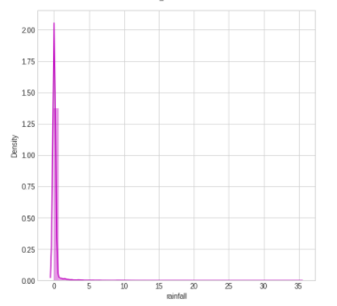
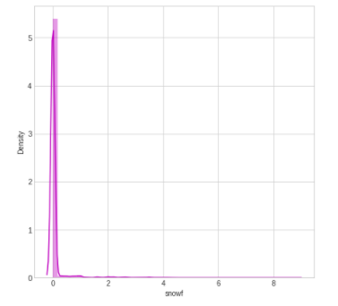
EDA
Rainfall and Snowfall both are positively skewed.
Fig 8: Distribution of Rainfall.
Fig 9: Distribution of Snowfall.

Slide 14
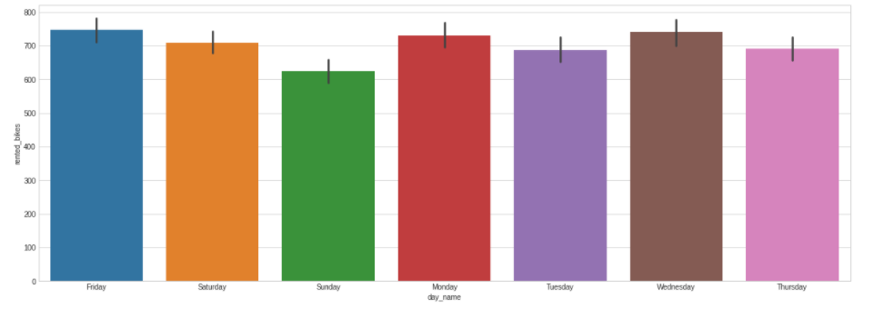
EDA
From graph we can say less bikes are rented on Sunday as compared to other days.
Fig 10 Bar plot in between Rented bikes and Days

Slide 15
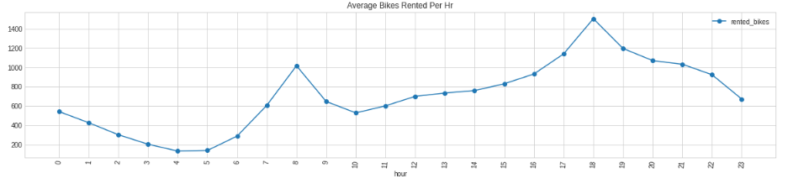
EDA
Maximum bikes are rented on 8 am and 6 pm.
Fig 11 Count plot in between Rented bikes and Hours

Slide 16
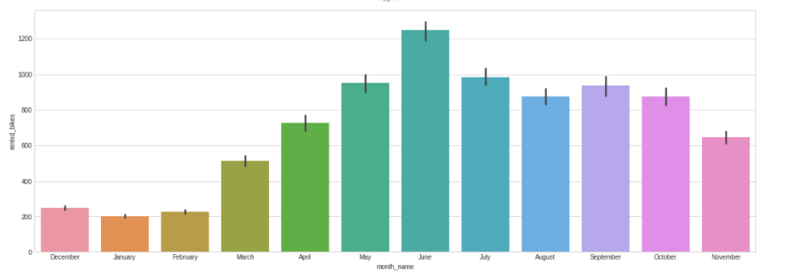
EDA
In June month (in summer) more bikes are rented as compared to other.
Fig 12 Count plot in between Rented bikes and Months

Slide 17
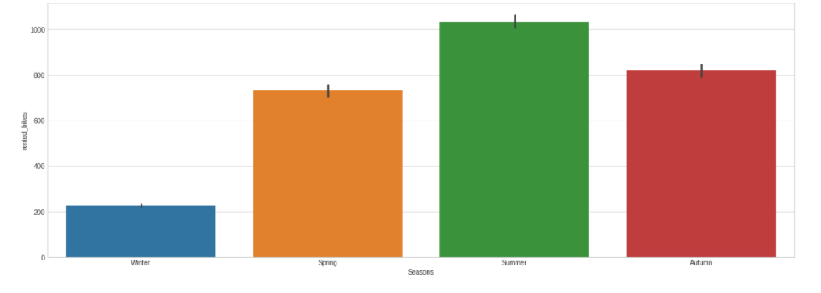
EDA
From graph we can say more bikes are rented in summer and less bikes are rented in winter.
Fig 13 Count plot in between Rented bikes and Seasons

Slide 18
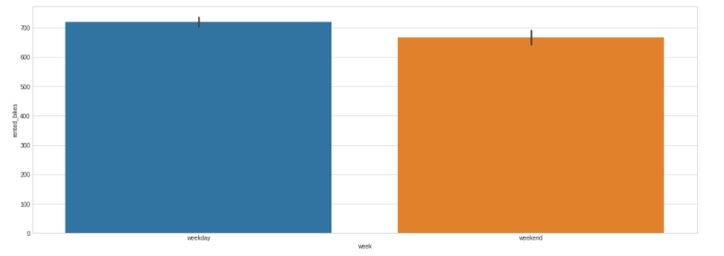
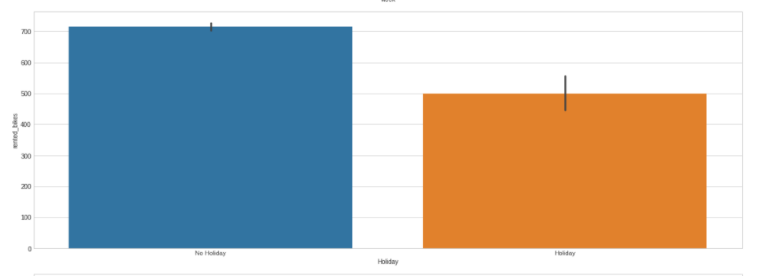
EDA
From fig 14 we can say there not more difference in demand of bikes between weekday and weekend
From fig 15 we see there is a difference in demands of bike in No holiday and Holiday.
Fig 14 Count plot of Week day and Week end.
Fig 15 Count plot of No holiday and Holiday.

Slide 19
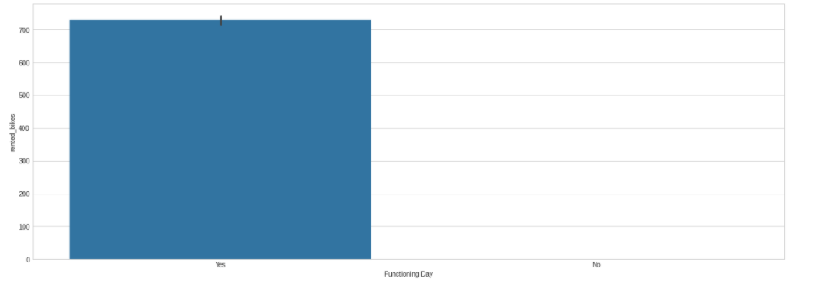
EDA
In data there are very less No function day as compared to Function day.
Fig 16 Count plot of Function day and No Function day.

Slide 20
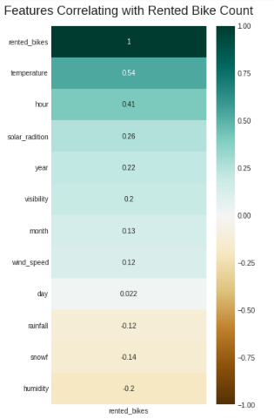
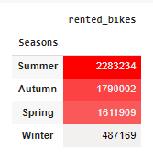
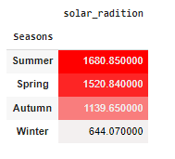
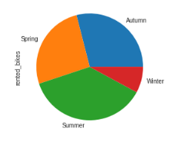
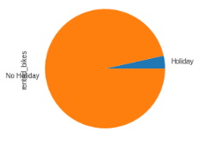
EDA
Fig 17 Count plot of Rented bike and Seasons
Fig 18 Count plot of Solar radiation and Seasons
Fig 20 Pi plot of Holiday No holiday
Fig 19 Pi plot of Seasons
Fig 21 Heat map Rented bike and other factors

Slide 21
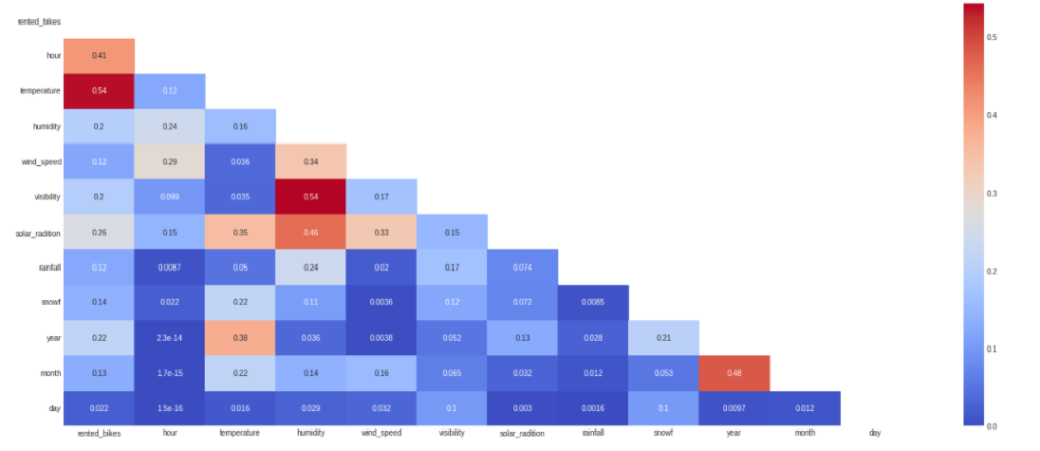
EDA
Fig 22 Heat map of variables

Slide 22
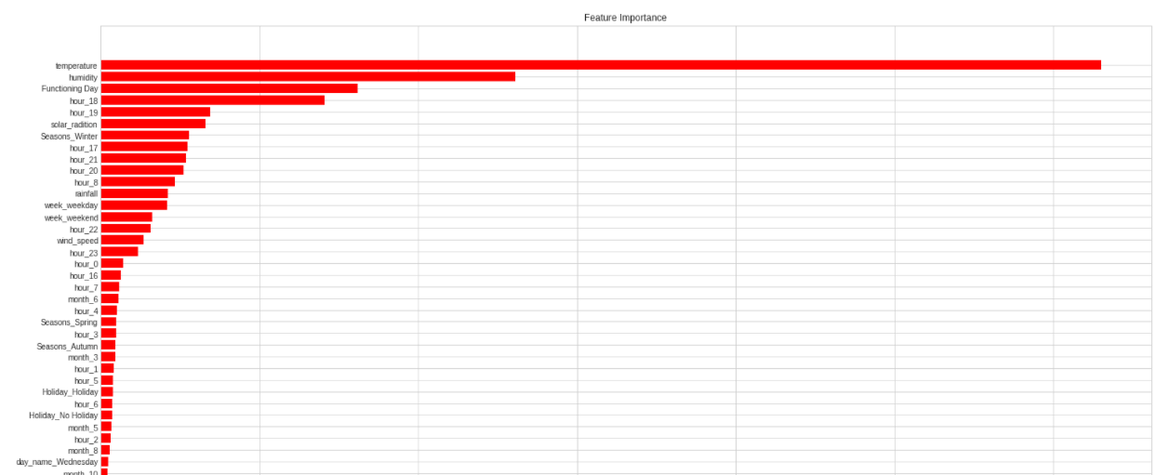
EDA
Fig 23 Feature importance bar plot.

Slide 23
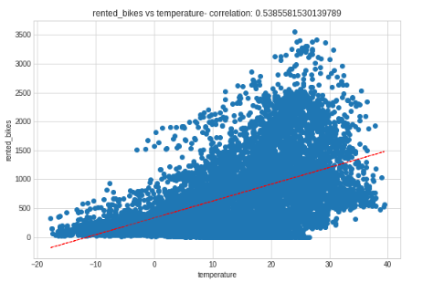
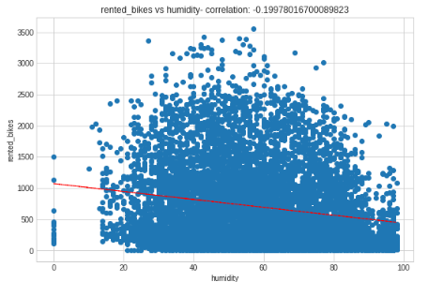
Statistical Data Analysis
From fig 24 temperature and rented bikes are positively co related and from fig 25 humidity and rented biked are negatively co related.
Fig 24 Co-relation plot in Rented bike and Temperature.
Fig 25 Co-relation plot in Rented bike and Humidity.

Slide 24
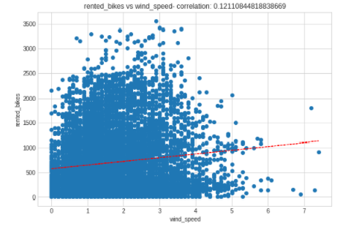
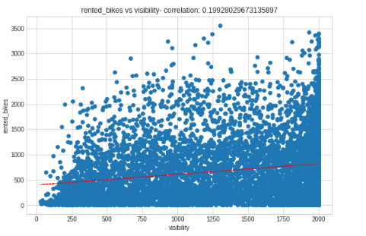
Statistical Data Analysis
Fig 26 and fig 27 Wind speed and visibility both are positively co related with rented bikes.
Fig 26 Co-relation plot in Rented bike and Wind speed.
Fig 27 Co-relation plot in Rented bike and Visibility.

Slide 25
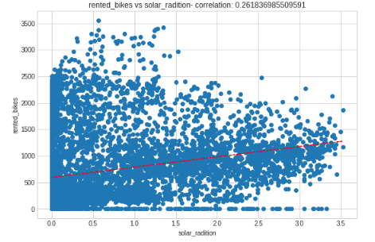
Statistical Data Analysis
Solar radiation and rented bike counts are positively co related.
Fig 28 Co-relation plot in Rented bike and Solar radiation

Slide 26
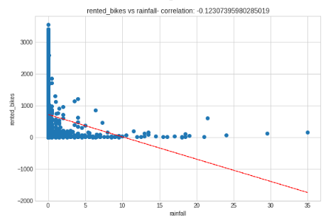
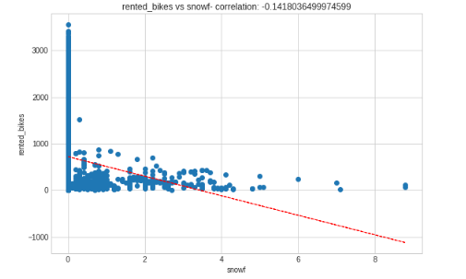
Statistical Data Analysis
Rain fall and Snow fall both are negatively co related with rented bike count.
Fig 29 Co-relation plot in Rented bike and Rainfall.
Fig 30 Co-relation plot in Rented bike and Snowfall.

Slide 27
Hypothesis
With EDA we can justify our hypothesis.
In season summer bike demand will be more.(Fail to reject)
If there is less visibility bike demand will be less.(Reject)
In the hours 9 am and 7 pm demands will be more.(Reject)
On Sunday bike demands will be less.(Fail to reject)
With rainfall and snow fall demands of bike will be reduced.(Fail to reject)

Slide 28
Model implementation
Various types of linear model are implemented on data such as Linear regression, Ridge regression, Lasso regression, Elastic net regression and Polynomial feature regression. As we can see from table the result accomplished are good but not satisfying.
Model | MSE (Train) | RMSE(Train) | R2(Train) | MSE (Test) | RMSE(Test) | R2(Test)
Linear Regression | 115071.02 | 339.22 | 0.72 | 112112.97 | 339.22 | 0.72
Ridge | 115073.23 | 339.22 | 0.73 | 112092.51 | 334.80 | 0.72
Lasso | 115071.14 | 339.22 | 0.72 | 112102.68 | 334.81 | 0.72
Elastic Net | 115080.73 | 339.23 | 0.72 | 112074.51 | 334.77 | 0.72
Polynomial Feature | 29566.78 | 171.94 | 0.92 | 40725.48 | 201.80 | 0.90
Table 1 Result table of linear models.

Slide 29
Model implementation
So we have to move towards some complex models such as Decision tree regressor, Random forest regressor, XG boost regressor and Cat boost regressor
Model | MSE (Train) | RMSE(Train) | R2(Train) | MSE (Test) | RMSE(Test) | R2(Test)
Decision tree regressor | 0.0 | 0.0 | 1.0 | 63029.50 | 251.05 | 0.84
Random forest regressor | 4811.62 | 69.36 | 0.98 | 33822.95 | 183.91 | 0.91
XG boost | 10073.27 | 100.36 | 0.97 | 36204.99 | 190.27 | 0.97
Cat boost | 101028.40 | 317.84 | 0.75 | 104605.09 | 323.42 | 0.75
Table 2 Result table of Complex models.

Slide 30
Model validation and selection
Best results on model is obtained from Random forest regressor and XG boost regressor.
After implementation of Grid search CV on both models final accuracy (r2) for XGB was more.
Model | MSE (Train) | RMSE(Train) | R2(Train) | MSE (Test) | RMSE(Test) | R2(Test)
Random forest regressor | 4811.62 | 69.36 | 0.98 | 33822.95 | 183.91 | 0.91
XG boost | 10073.27 | 100.36 | 0.97 | 36204.99 | 190.27 | 0.97
Table 3 Result table after implementation of Grid search CV on Complex models.

Slide 31
Conclusion
Bicycle sharing systems can be the new boom in India, with use of various prediction models the ease of operations will be increased.
During implementation of linear models accuracy obtained was not more so we moved towards more complex models.
With application of Decision tree regressor, Random forest regressor, XG boost regressor and Cat boost regressor we got higher accuracy.
Out of which Random forest regressor, XG boost regressor have more accuracy.
With the application of Grid search CV on both finally we got more accuracy for XG boost regressor. As r2 = 0.97 and RMSE = 190.27.

Slide 32
References
[1] “Short-Term Prediction of Bike-Sharing Demand Using Multi-Source Data: A Spatial-Temporal Graph Attentional LSTM Approach” by Xinwei Ma 1 , Yurui Yin 1 , Yuchuan Jin 2 , Mingjia He 3 and Minqing Zhu 4
[2]https://www.computerscijournal.org/vol10no1/prediction-of-bike-sharing-demand/
[3]https://link.springer.com/chapter/10.1007/978-3-030-94751-4_25
[4] Foell, S., Phithakkitnukoon, S., Kortuem, G., Veloso, M., Bento, C., 2015. Predictability of public transport usage: A study of bus rides in lisbon, portugal. IEEE Transactions on Intelligent Transportation Systems 16, 2955–2960.
[5] Gers, F.A., Schmidhuber, J., Cummins, F., 1999. Learning to forget: Continual prediction with lstm .

Slide 33
Thank You…

